Slide 1
PGP and S/MIME

Slide 2
Secure e-mail
How do you do it?
  Need to worry about sniffing, modifying, end-user masquerading, replaying.
  If sender and receiver have shared secret keys, then straightforward.
  Can use public-key cryptography to distribute keys.
  But users do not want to hassle with certificate authority.

Slide 3
Pretty Good Privacy (PGP)
Why Use It?
Privacy - Store and transmit your data so that only select people may view their contents.
Integrity - Ensure your files, data, and applications have not been modified without your consent.
Authentication - A way to verify that people actually are who they claim to be.

Slide 4
Pretty Good Privacy (PGP)
Overview & History
PGP is a personal high-security cryptographic software application that allows people to exchange messages or files with privacy, authentication, and convenience. PGP can be used to encrypt and digitally sign files and e-mail.
Developed by Phil Zimmerman in the mid ‘80s.
First version released on the Internet in 1991; got immediate NSA attention and encountered legal issues on its use of RSA and Merkle-Hellman cryptography patents.
Purchased by ViaCrypt in 1993 (they had RSA license). Re-released in 1994 with RSAREF toolkit license.
Purchased by Network Associates in 1998.

Slide 5
Pretty Good Privacy (PGP)
Versions
PGP v2.6.2 (MIT PGP) is the current version for DOS/UNIX platforms for use within the U.S. (v2.6.3i is for use outside the U.S.)
PGP v5.x freeware is also available for DOS/Windows/ UNIX platforms although it is generally regarded as not as secure as v2.x. Additionally, the v5.x freeware version is not backward compatible with PGP v2.x.
PGP v6.x (NAI PGP) is the current commercial product which offers “PGP Desktop Security,” “PGP Personal Privacy,” and “PGP Freeware.” (The freeware version is not backward-compatible with MIT PGP.)

Slide 6
PGP
Hash:
  SHA-1
  160 bits
Public key cryptography:
  RSA
Question: Why digital signatures for authentication? Why not a MAC?
  Could use public-key crypto to get a shared key.
  But if there are 100 recipients? Need to distribute 100 MAC keys.

Slide 7




Confidentiality
Alice wants to send confidential e-mail, m, to Bob.
K_{S}
.
K_{S}(m )
K_{S}(m )
.
m
K_{S}( )
K_{S}( )
m
+
-
K_{S}
Internet
.
.
+
-
K_{S}
K_{B}( )
+
+
K_{B}( )
K_{B}(K_{S} )
K_{B}(K_{S} )
+
-
K_{B}
K_{B}
Alice:
generates random symmetric key, K_{S}.
encrypts message with K_{S} (for efficiency)
also encrypts K_{S} with Bob’s public key.
sends both K_{S}(m) and K_{B}(K_{S}) to Bob.

Slide 8
Confidentiality
Alice wants to send confidential e-mail, m, to Bob.
K_{S}
.
K_{S}(m )
K_{S}(m )
.
m
K_{S}( )
K_{S}( )
m
+
-
K_{S}
Internet
.
.
+
-
K_{S}
K_{B}( )
+
+
K_{B}( )
K_{B}(K_{S} )
K_{B}(K_{S} )
+
-
K_{B}
K_{B}
Bob:
uses private key to obtain K_{S}
uses K_{S} to decrypt K_{S}(m)

Slide 9
Confidentiality: PGP
Session key: 128 bits
Symmetric encryption:
  CAST-128 or IDEA or 3DES
Public key encryption
  RSA

Slide 10
Secure e-mail: Confidentiality and Authentication
Alice wants to provide secrecy, sender authentication,
message integrity.
-
K_{A}
.
.
-
-
K_{A}(H(m))
K_{S}
m
H( )
K_{A}( )
.
+
K_{S}( )
m
+
Internet
.
+
K_{S}
K_{B}( )
+
K_{B}(K_{S} )
+
K_{B}
Alice uses three keys: her private key, Bob’s public key, newly created symmetric key

Slide 11
PGP key rings
Each node has two key rings:
  Public/private key pairs owned by that node
  Public key of other users
For the keys of other users, for each key track:
  user id: e-mail address, name, address, etc.
  public key
  timestamp: date when key was generated
  key ID
  key legitimacy
  signatures

Slide 12
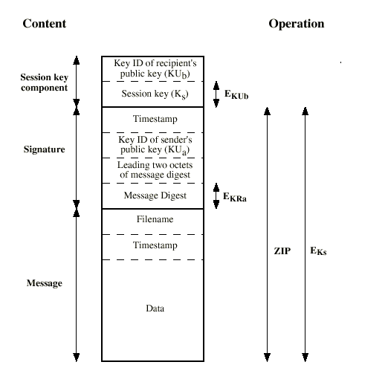
Format of PGP Message
Users may have multiple key pairs
  Key ID’s: last 64 bits of public key
Message component
Signature component
  Timestamp
  Key ID of
  Mess digest:
  Leading two octets in clear, to verify correct key is being used
Session key component
  key ID of K_{B}
  Session key: K_{S}
+
K_{A}
-
K_{A}(H(m))
+

Slide 13
PGP Trust
No certificate authority
How does Alice obtain Bob’s public key?
Alice physically gets key from Bob
Or from phone conversation
Or gets Bob’s key from Claire, who Alice may or may not trust
For a key in your key ring:
Can you trust that key really belongs to the person defined by the user-id?
Can you trust that user-id to vouch for other keys?
For each key on ring:
Key legitimacy field indicates how much you trust this key to be valid for the associated user.
  Determined by PGP algorithm
Signatures for key. Each signature signed with private key of some user
Also, key ring includes trust values for owners of keys in key ring
  Determined by you.

Slide 14
Public key management: example
Suppose Alice inserts new public key in key ring. If Alice is owner, trust assigned to Alice is ultimate.
Otherwise, Alice must assign trust value to owner of key:
  unknown
  untrusted
  marginally trusted
  completely trusted.
New public key may come with signatures vouching for the key. For each signature, PGP searches ring to see if author of signature is in key ring.
Key legitimacy = legit if one signature completely trusted. Otherwise, determined from formula based on trust of signatures: above threshold, key is considered legit

Slide 15
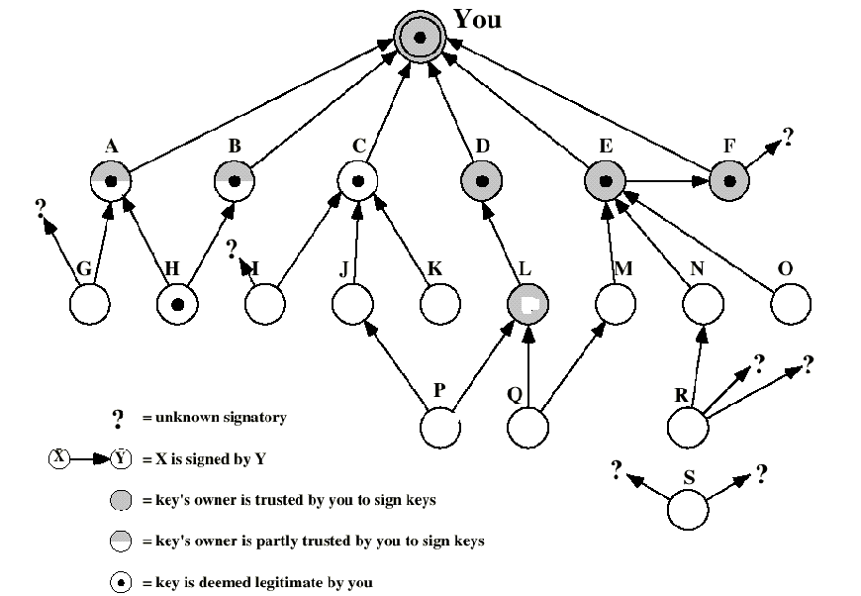
Example
You first assign trust
levels to users
2) PGP estimates which
keys are legit
legit and
trusted
legit, not
trusted

Slide 16
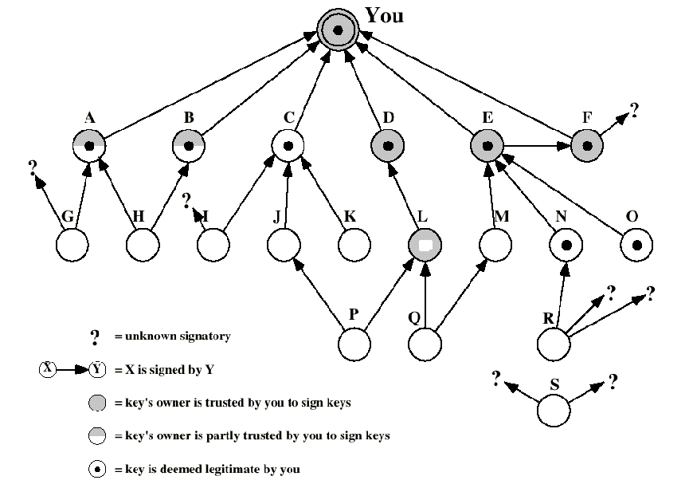
Example
You first assign trust
levels to users
2) PGP estimates which
keys are legit
legit and
trusted
legit, not
trusted

Slide 17
PGP summary
PGP provides security at the application layer to a single application
Provides:
  Authentication, integrity, confidentiality
Public key verification
  Web of trust

Slide 19
S/MIME (Secure/Multipurpose Internet Mail Extensions)
security enhancement to MIME email
  original Internet RFC822 email was text only
  MIME provided support for varying content types and multi-part messages
  with encoding of binary data to textual form
  S/MIME added security enhancements
have S/MIME support in many mail agents
  eg MS Outlook, Mozilla, Mac Mail etc
Notes:
S/MIME (Secure/Multipurpose Internet Mail Extension) is a security enhancement to the MIME Internet e-mail format standard, which in turn provided support for varying content types and multi-part messages over the text only support in the original Internet RFC822 email standard. MIME allows encoding of binary data to textual form for transport over traditional RFC822 email systems. S/MIME support is now included in many modern mail agents.

Slide 20
MIME
Here is a summary of the different MIME content types:
Type
Subtype
Description
Text
Plain
Enriched
Unformatted text (ASCII or ISO 8859).
Provides greater format flexibility.
Multipart
Mixed
Parallel
Alternative
Digest
The different parts are independent but are to be transmitted together. Should be presented to the receiver in their original order.
Differs from mixed only in that no order is defined.
The different parts are alternative versions of the same information.
Similar to Mixed but the default type/subtype of each part is message/rfc822.
Message
rfc822
Partial
External body
The body is itself an encapsulated message that conforms to RFC822.
Used to allow fragmentation in a transparent way to the recipient.
Contains a pointer to an object exists else where.

Slide 21
MIME (contd.)
Type
Subtype
Description
Image
Jpeg
gif
The image is in JPEG format.
The image is in GIF format.
Video
Mpeg
MPEG format.
Audio
Basic
Single-channel 8-bit ISDN mu-law encoding at a sample rate of 8kHz
Application
Postscript
Octet-stream
Adobe Postscirpt.
General binary data consisting of 8-bit bytes.

Slide 22

MIME (contd.)
The other major component of MIME is a definition of transfer encodings for message contents:
Encoding
Description
7bit
The data are all represented by short lines of ASCII chars.
8bit
The lines are short, but there may be non-ASCII chars.
Binary
Not only may non-ASCII chars be presented but lines are not necessarily short enough for SMTP transport.
Quoted-printable
Encodes the data in such a way that if the data being encoded are mostly ASCII text, the encoded form of the data remains largely recognizable by humans.
Base64
Encodes data by mapping 6-bit blocks to 8-bit printable ASCII characters blocks.
x-token
A nonstandard encoding.

Slide 23
S/MIME - Overview
S/MIME provides the following cryptography security services:
  Authentication.
  Message Integrity. By using digital signing
  Non-repudiation of origin.
  Privacy and data security. By using encryption
There are three versions of S/MIME:
  S/MIME version 1 (1995)- was specified and officially published in 1995 by RSA Security, Inc.
  S/MIME version 2 (1998)- was specified in a pair of informational RFC documents - RFC 2311 and RFC 2312 - in March1998.
  The work was continued in the IETF S/MIME Mail Security (SMIME) WG and resulted in S/MIME version 3 (1999) specified in RFCs 2630 to 2634 in June 1999.

Slide 24
MIME - Overview
RFC 822 defines a format for text messages that are sent using electronic mail.
SMTP/RFC822 scheme limitations:
SMTP cannot transmit executable files or other binary files.
SMTP cannot transmit text data that includes national language characters because these are represented by 8-bit codes with values of 128 decimal or higher, and SMTP is limited to 7-bit ASCII.
SMTP servers may reject mail message over a certain size.
SMTP gateways that translate between ASCII to EBCDIC suffer translation problems.
Some SMTP implementations do not adhere completely to the SMTP standard defined in RFC 822.

Slide 25
S/MIME Functions
enveloped data
  encrypted content and associated keys
signed data
  encoded message + signed digest
clear-signed data
  cleartext message + encoded signed digest
signed & enveloped data
  nesting of signed & encrypted entities
Notes:
In terms of general functionality, S/MIME is very similar to PGP. Both offer the ability to sign and/or encrypt messages. S/MIME provides the functions shown.

Slide 26
S/MIME - Functions
S/MIME is based on the Cryptographic Message Syntax
(CMS) specified in RFC 2630.
Enveloped data:
This consists of encrypted content of any type and encrypted content encryption keys for one or more users. This functions provides privacy and data security.
Signed data:
A digital signature is formed by signing the message digest and then encrypting that with the signer private key. The content and the signature are then encoded using base64 encoding.
This function provides authenticity, message integrity and non-repudiation of origin.

Slide 27
S/MIME - Functions
SignerInfo: allows the inclusion of unsigned and signed attributes to be included along with a signature.
  signingTime
  sMIMECapabilities
  sMIMEEncryptionKeyPreference

Slide 28
S/MIME - Functions
Clear signed data:
In this case a digital signature of the content is formed, However only the signature is encoded with base64.
Signed and enveloped data:
Because of S/MIME encapsulating capability (multipart type), signed only and encrypted only entities may be nested, so that encrypted data may be signed and signed data may be encrypted.

Slide 29
S/MIME - Cryptography
Used Algorithms:
Function
Requirement
Creation of a message digest.
MUST support SHA-1. SHOULD use sha-1.
Receiving agents SHOULD support MD5 for the purpose of providing backward compatibility with S/MIME v2.
A message digest encryption to form a digital signature.
Both sending and receiving agents MUST support DSS.
Receiving agents SHOULD support verification of RSA signatures with key sizes 512 bits to 1024 bits. Note that S/MIME v2 clients are only capable of verifying digital signatures using RSA.

Slide 30
S/MIME - Cryptography
Function
Requirement
A session key encryption for transmission with the message.
Both sending and receiving agents MUST support Diffie-Hellman.
Sending agents SHOULD support RSA encryption with key sizes 512 to 1024 bits.
Receiving agents SHOULD support RSA decryption.
A message Encryption for transmission with one-time session key.
Sending an receiving agent MUST support Encryption/Decryption with 3DES.
Receiving agents SHOULD support decryption with RC2/40.
(S/MIME V 2. - Sending agents SHOULD support RSA encryption with 3DES
and RC2/40. Receiving agents MUST support decryption with RC2/40.)

Slide 31




S/MIME - Message
Enveloped Data:
Recipient’s public key
Diffie-Hellman / RSA
Encrypt the session key
Pseudorandom
session key
(3DES or RC2/40)ׁׁ
Certificate
RecipientInfo
M
enveloped-data
+

Slide 32

S/MIME - Message
SignedData:
Sender’s private key
Hash function
SHA-1 or MD5
Encryption
M
Certificate
SignerInfo
Base64 encoding

Slide 33
S/MIME - Message
Clear signing:
Clear signing is achieved using the multipart content type with a signed sub-type .
Two parts:
  Clear text (or any MIME type) encoded in base64.
  SignedData.

Slide 34
S/MIME - Message
This parameter indicates that this is a two part clear-signed entity.
Content-Type: multipart/signed;
        protocol=“application/pkcs7-signature”;
        micalg=sha1; boundary=boundary42
--boundary42
Content-Type: text/plain
This is a clear-signed message.
--boundary42
Content-Type: application/pkcs7-signature;
name=smime.p7s
Content-Transfer-Encoding: base64
Content-Disposition: attachment; filename=smime.p7s
ghyHhHUujhJhjH77n8HHGTrfvbnj756tbB9HG4VQpfyF467GhIGfHfYT6
4VQpfyF467GhIGfHfYT6jH77n8HHGghyHhHUujhJh756tbB9HGTrfvbnj
n8HHGTrfvhJhjH776tbB9HG4VQbnj7567GhIGfHfYT6ghyHhHUujpfyF4
--boundary42--
This parameter indicates the type of message digest used.
Unsigned Data
SignerInfo
Header

Slide 36
Pretty Good Privacy (PGP)
Basic Usage & Key Management
To encrypt file with recipent's pubkey: pgp -e textfile her_userid [other userids]
To sign a file with your secret key:
pgp -s textfile [-u your userid]
To sign a file with your secret key, and encrypt it with recipent's pubkey:
pgp -es textfile her_userid [-u your_userid]
To decrypt or check a signature for a ciphertext (.pgp) file: pgp ciphertextfile
To produce encryption/signature output in ASCII for email, add the -a option to above options.
To generate your own unique public/secret key pair: pgp -kg
To add a key file's contents to your public or secret key ring:pgp -ka keyfile [keyring]

Slide 37
Pretty Good Privacy (PGP)
Basic Use & Key Management (Continued)
To remove a key or a user ID from your public or secret key ring: pgp -kr userid [keyring]
To edit your user ID or pass phrase:
pgp -ke your_userid [keyring]
To check signatures on your public key ring:
pgp -kc [userid]
To sign someone else's public key on your public key ring:
pgp -ks her_userid
To view the contents of your public key ring:
pgp -kv

Slide 38
Pretty Good Privacy (PGP)
Generating a Key
To create a new key: pgp -kg
Select option 3: 1024 bits-"Military" grade, slow, highest security
Enter a user ID for the new key (usually name followed by email address: Joe Public <jpublic@public.com>
Enter a pass phrase. This phrase is used to encrypt your secret key.
* do not use the same password or pass phrase that is
used on another system
* do not use common words or proper names
* do not use any single word that may be contained in a
dictionary

Slide 39
Pretty Good Privacy (PGP)
Generating a Key
Use an actual phrase and not just a single password.
Example of a good pass phrase: “Sew ewe theenk ewe kan haq mie passfraze bye heereeng mee saye it 2 tymez?”
NOTE: passphrases are case-sensitive!
Do not use lines from history, popular movies or books!
The last step is to input random text in order to generate a series of random bits. This is done by measuring the time intervals between keystrokes.
The random bits are used to create the user’s keys.
The generated keys will be placed on your public and private keyrings.

Slide 40
Pretty Good Privacy (PGP)
PGP Public Key Certificates
PGP stores each public key in a key certificate which contains:
  The public key itself.
  The ID of the key’s creator (usually name & email address).
  The date the key was created & expiration date.
  A list of digital signatures provided by people who attest to the key’s authenticity.

Slide 41
Pretty Good Privacy (PGP)
Encrypting & Decrypting Files
To encrypt a file with a recipient’s public key:
pgp -e <filename> <user ID>
This will produce the file filename.pgp Only the recipient can decrypt the file using their private key.
The recipient can decrypt the file with:
pgp filename.pgp
They will then be prompted to enter their private key pass phrase.
Note: Whenever encrypting text files to send via the Internet also use the ‘a’ option for ASCII output

Slide 42
Pretty Good Privacy (PGP)
Digital Signatures
To add a digital signature to a file:
pgp -sta filename
The user will be prompted to enter their pass phrase.
The file <filename.asc> will be created which contains the digital signature of the sender.
The recipient can verify the digital signature to ensure the files contents have not changed: pgp filename.asc

Slide 43
Pretty Good Privacy (PGP)
Digital Signatures
The recipient will be notified if the file has a good signature:
Good signature from user "Joe Public<jpublic@public.com>".
Signature made 1998/07/27 04:29 GMT
If the file had been modified even by one byte the recipient would be advised that the signature was not valid:
Bad signature from user "Joe Public <jpublic@public.com>".
Signature made 1998/07/27 04:29 GMT

